Slide 2
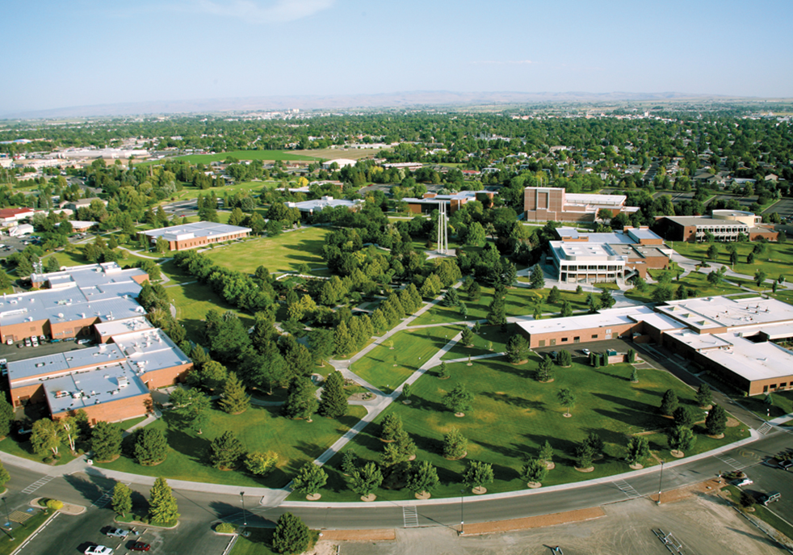
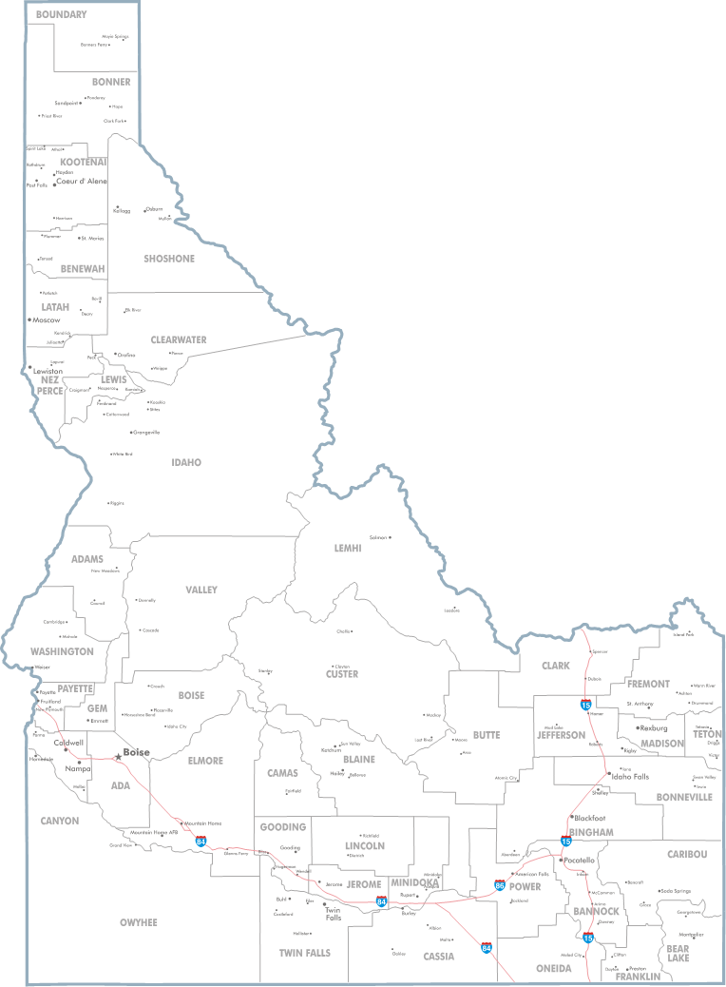
College of Southern Idaho
2 Year Institution
8,500 Students
Twin Falls Idaho
Average Class Size-20 Students
Tuition- $3,900 per year

Slide 3
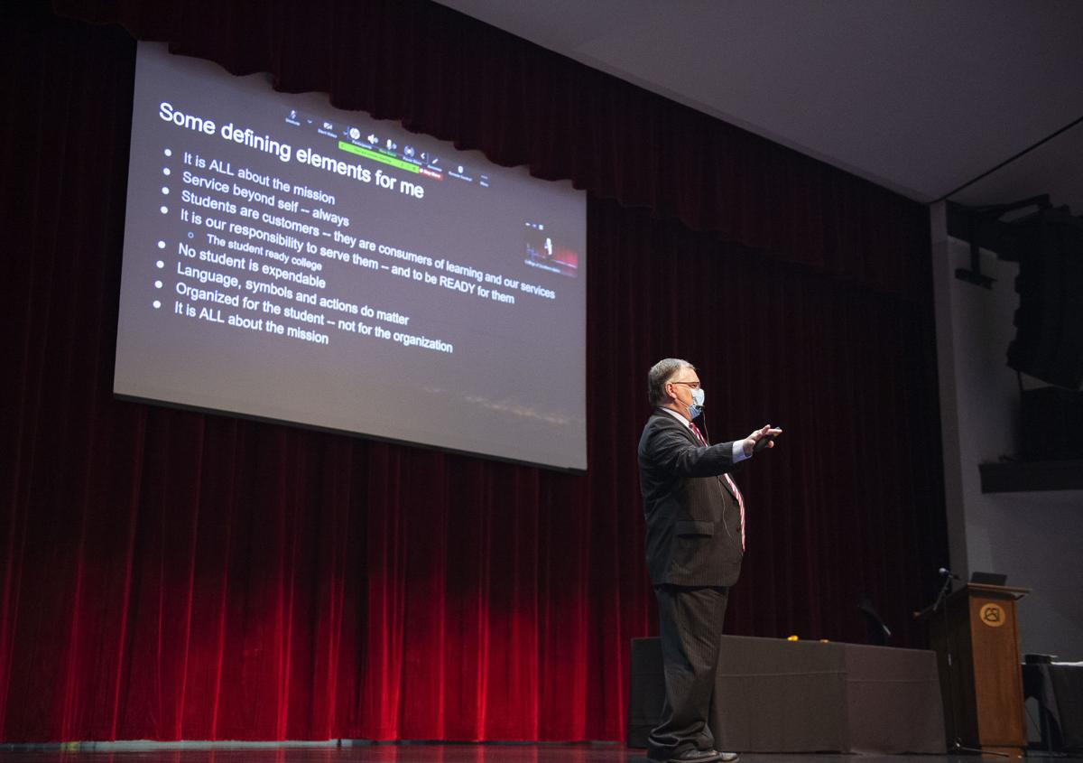
New President- Dr. Dean Fisher

Slide 4
Associates Degree in Fire Service Technology

Slide 5
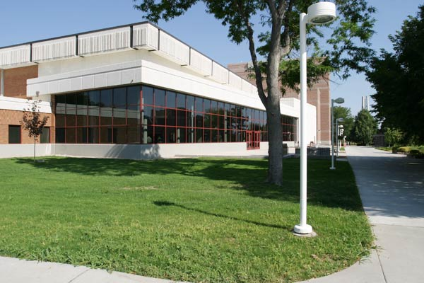
Transcript and Test Score Changes

Slide 6
Visit Campus
Individual Tours:
By Appointment
Limited To Two People
Masks Encouraged
Social Distanced
Group Tours:
Currently Not Being Scheduled

Slide 7
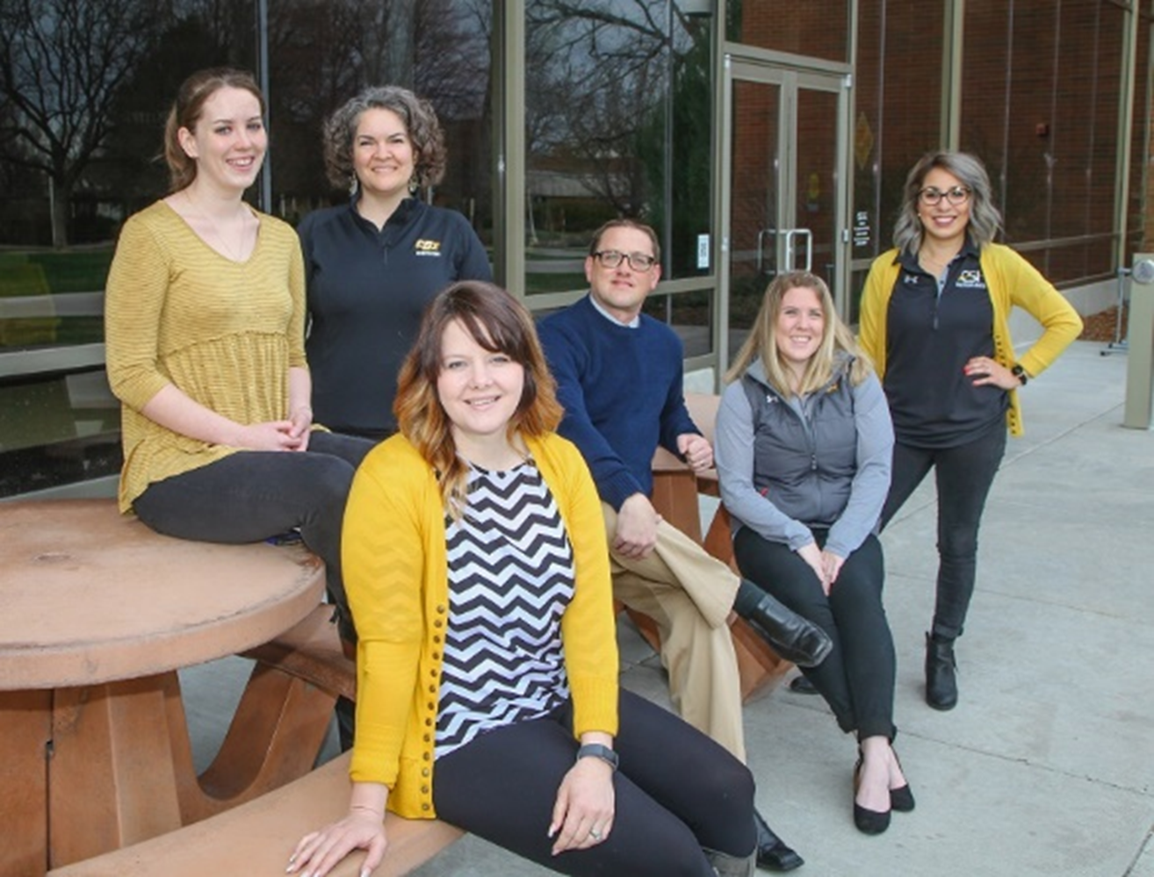
Contact Us
Admissions Office
208-732-6221
admissions@csi.edu
Individual Tours
Group Tours
On Campus Events
School Visits

